Slide 1
Alert and Action
Microsoft Power Platform
Govern
&
Grow
1. Secure
2. Monitor
3. Alert and Action
4. Deploy
5. Nurture
6. Infrastructure
7. Support

Slide 2
Governance – Practically Applied
Secure
Monitor
Manage
Set up Azure AD conditional access Enable cross-tenant isolation Configure data loss prevention policies Define your environment strategy Manage users and their security roles Configure email exfiltration Define your data gateways strategy |  | Track user access Monitor new connectors Report on resource usage Monitor Dataverse usage Set up sharing alerts and mitigations Leverage audit logs from O365 pipeline |  | Automate policies using management connectors Leverage admin PowerShell or admin APIs for automation
Application Lifecycle Management
Managed vs Unmanaged
Learn ALM best practices
Automate ALM using Azure DevOps
Nurture and educate
Establish a Center of Excellence
Educate new makers
Foster best practices
Notes:
It requires focus on multiple aspects including security, monitoring, management, and application lifecycle management for your particular organization. In our Power Platform Governance series, we’ll show you how the Power Platform offers you capabilities in each of these different and important elements for your Power Platform deployment. The tools within the Power Platform help reduce the complexity of governing your environment and empowers admins to unlock the greatest benefits from their Power Platform assets.
Notes (09/24)
Check if it matches the guidelines, best practices
Precursor slide: personas (SOC, IT, all admins, security teams)
Visual: Emphasize that the “secure” is what were gonna focus
https://docs.microsoft.com/en-us/power-platform/guidance/adoption/admin-best-practices
Maybe remove “ALM and nurture and educate”

Slide 3
Scenarios
Get notifications when resources are created and follow-up actions with app creators
Drive company policies
Automate environment creation

Slide 4


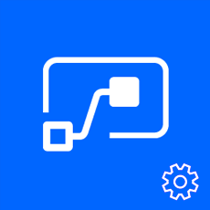


Leverage automation tooling for audit process and reporting
Pull the metadata you need to build the custom reports you want
Build the policies you need to implement administration + governance requirements. Use the management connectors to permit or restrict behavior based on your organization’s policie
PowerShell Cmdlets - aka.ms/powerappspowershell
Management connectors – Power Platform APIs in an accessible connector interface, provide admin access to resources
REST API – Leverage APIs directly from any programming language
Power Platform for Admins
Power Apps for Admins
Power Automate - Flow Management
Power Apps for App Makers

Slide 5
Automate with PowerShell cmdlets
The PowerShell Cmdlets place full control in the hands of admins to automate the governance policies necessary - aka.ms/powerappspowershell.
Separate cmdlets for app creators and administrators
Can be used with other service to automate full processes
e.g. Create User, Assign License, Create Environment all in one script

Slide 6
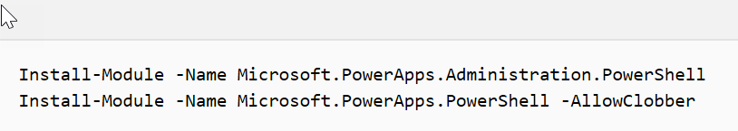
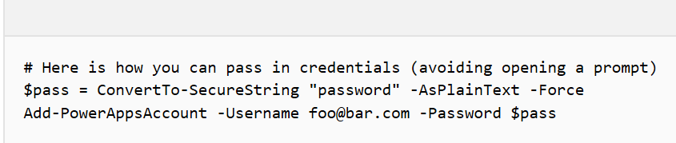
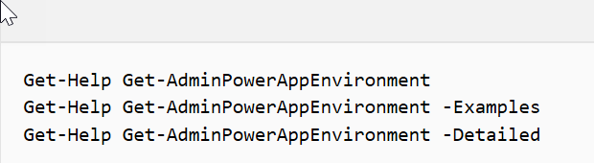
Getting started with PowerShell
Installing
Setting Credentials
Exploring Help
https://docs.microsoft.com/power-platform/admin/powerapps-powershell#powerapps-cmdlets-for-administrators-preview
Notes:
credentials are refreshed for up to ~8 hours before you’re required to sign in again to continue using the cmdlets.

Slide 7
Working with Environments and Dataverse
Environments
Dataverse
New-AdminPowerAppEnvironment
Set-AdminPowerAppEnvironmentDisplayName
Get-AdminPowerAppEnvironment
Get-AdminPowerAppEnvironmentLocations
Remove-AdminPowerAppEnvironment
New-AdminPowerAppDataverseDatabase
Get-AdminPowerAppDataverseDatabaseLanguages
Get-AdminPowerAppDataverseDatabaseCurrencies

Slide 8
Working with Power Apps Canvas apps
Canvas Apps
Canvas Permissions
Get-AdminPowerApp
Remove-AdminPowerApp
Get-AdminPowerAppConnectionReferences
Set-AdminPowerAppAsFeatured
Clear-AdminPowerAppAsFeatured
Set-AdminPowerAppAsHero
Clear-AdminPowerAppAsHero
Set-AdminPowerAppApisToBypassConsent
Clear-AdminPowerAppApisToBypassConsent
Get-AdminPowerAppRoleAssignment
Remove-AdminPowerAppRoleAssignment
Set-AdminPowerAppRoleAssignment
Set-AdminPowerAppOwner

Slide 9
Working with Power Automate
Basics
Permissions
Get-AdminFlow
Enable-AdminFlow
Disable-AdminFlow
Remove-AdminFlow
Remove-AdminFlowApprovals
Get-AdminFlowOwnerRole
Set-AdminFlowOwnerRole
Remove-AdminFlowOwnerRole
Approvals
Get-FlowApprovalRequest
Get-FlowApproval
RespondTo-FlowApprovalRequest

Slide 10
Working with Connectors
Connectors
Get-AdminPowerAppConnection
Remove-AdminPowerAppConnection
Permissions
Get-AdminPowerAppConnectionRoleAssignment
Set-AdminPowerAppEnvironmentConnectionRoleAssignment
Remove-AdminPowerAppConnectionRoleAssignment
Notes:
Same methods apply to custom connectors as well

Slide 11
Working with other tenant resources
Users
Data Loss Prevention
Get-AdminPowerAppsUserDetails
Get-AdminFlowUserDetails
Remove-AdminFlowUserDetails
Get-AdminDlpPolicy
New-AdminDlpPolicy
Remove-AdminDlpPolicy
Set-AdminDlpPolicy
Add-ConnectorToBusinessDataGroup
Remove-ConnectorFromBusinessDataGroup
Add-CustomConnectorToPolicy
Remove-CustomConnectorFromPolicy
Tenant Settings
Get-TenantSettings
Set-TenantSettings
$settings = @{ DisableEnvironmentCreationByNonAdminUsers = $true }
Set-TenantSettings $settings
Environment creation setting just launched in May ‘19

Slide 12
Data Loss Prevention SDK
This sample provides some DLP scenarios about how to call DLP APIs for your reference.
Create a tenant-level policy that classifies connectors into Business, Non-business, and Blocked groups.
Create policy for all environments except certain environments that classifies connectors into Business, Non-business, and Blocked groups.
Create policy for single environment that classifies connectors into Business, Non-business, and Blocked groups.
Get list of tenant-level policies (all environments).
Update policy to move connector across groups (Business, Non-business, and Blocked).
Test compatibility of existing policies that previously used legacy powershell APIs and now use new PowerShell APIs.
DLP SDK - Power Platform | Microsoft Docs

Slide 13
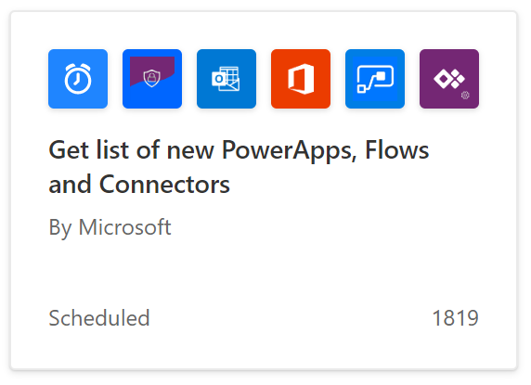

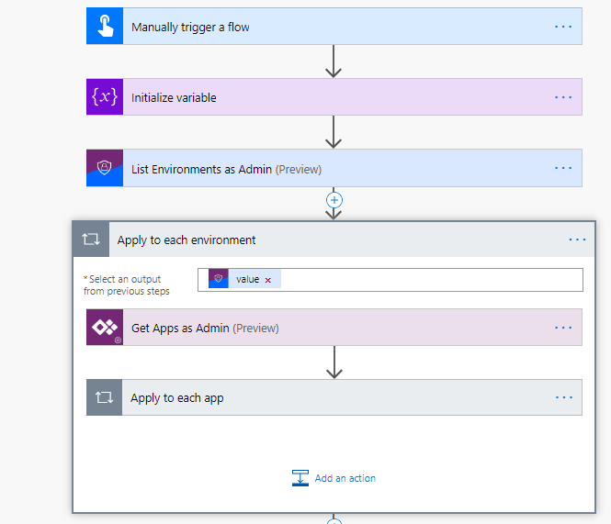
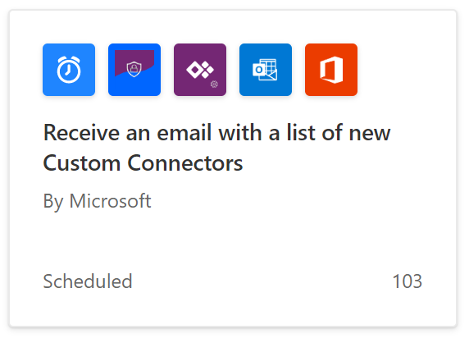
Leverage management connectors
Notes:
Show screenshot or demo if attendees are unfamiliar with what Flow looks like

Slide 14
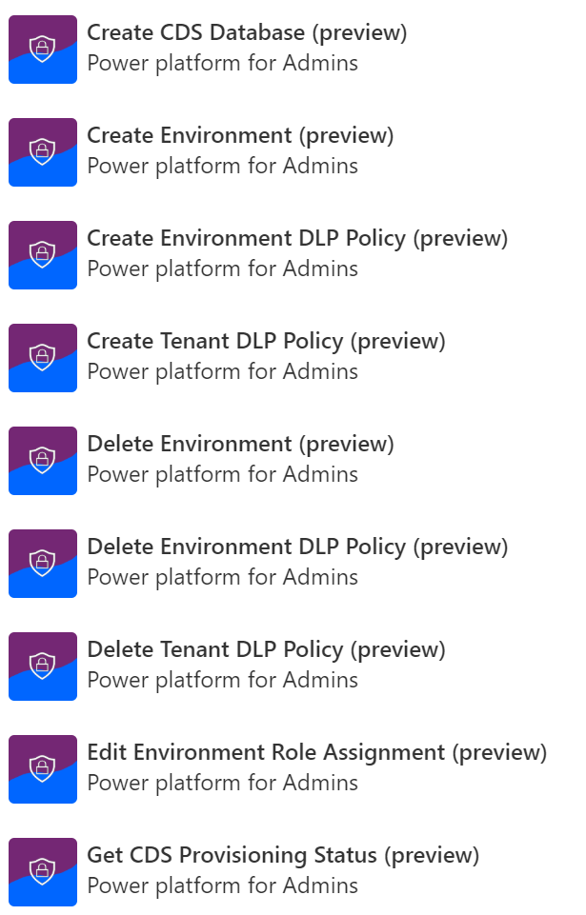
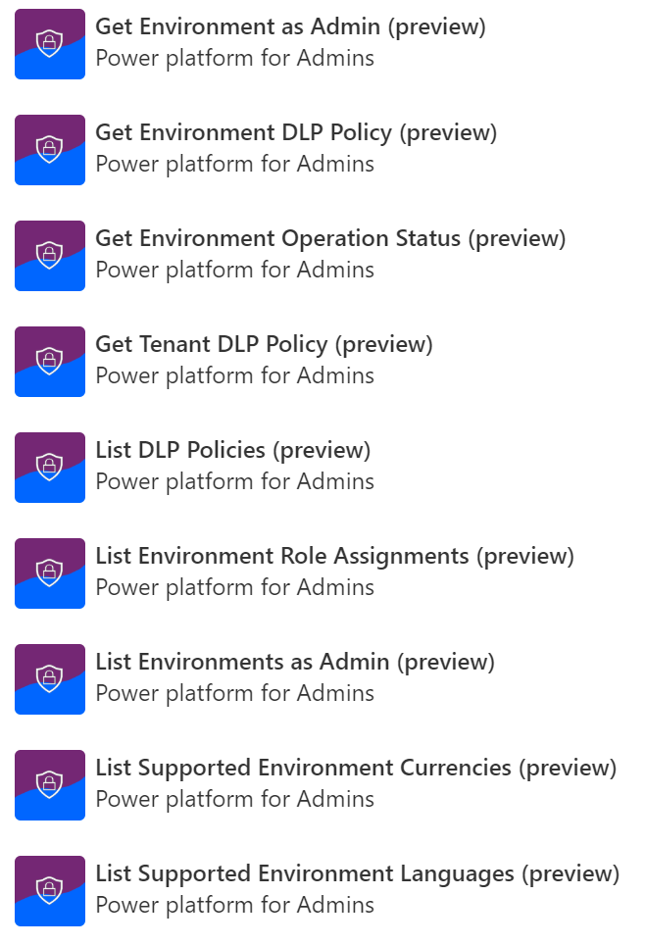
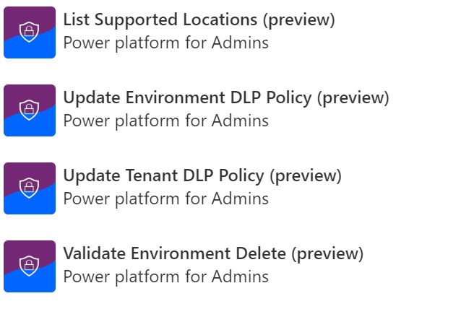
Power Platform for Admins

Slide 15
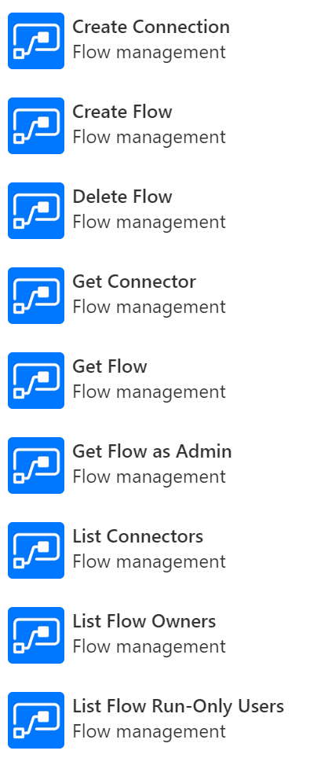
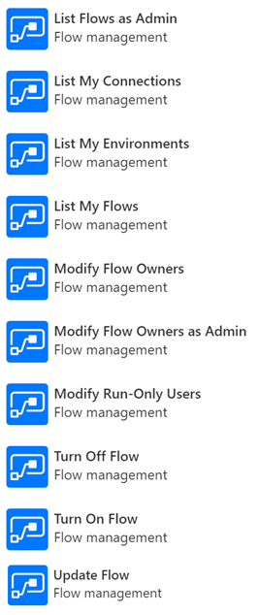
Power Automate Management

Slide 16
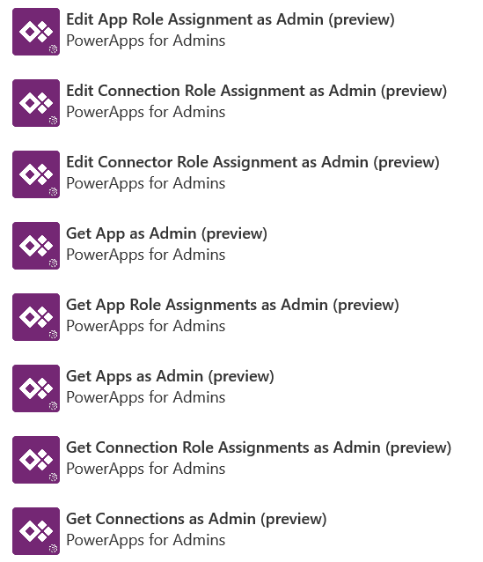
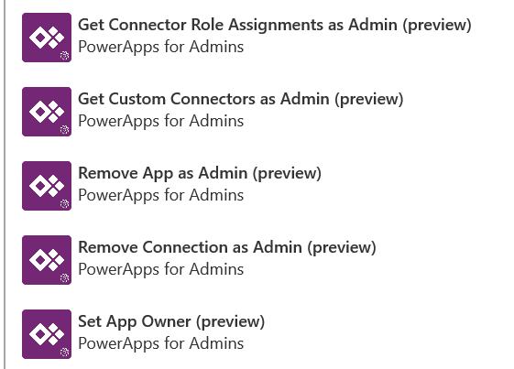
Power Apps for Admins

Slide 17
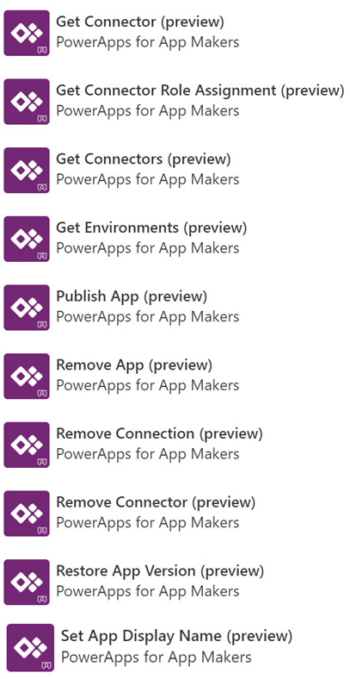
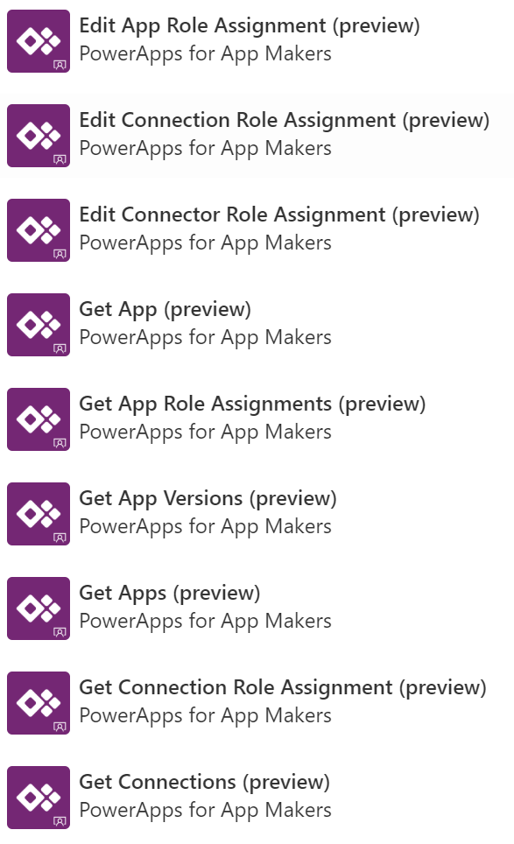
Power Apps for Makers

Slide 18

Automate audit and governance, some examples…
Create your own workflows using the management connectors that permit or restrict behavior based on your organization’s policies
Easier with PowerShell
Easier with Management Connectors
Pull numbers of environments, apps, and flows
Build your own admin Power App
Bulk create multiple environments with Dataverse
Automate environment creation with approvals
Cleaning up environments no longer needed
Get alerts when new resources are created
Change owner of app after someone leaves
Create your own reactive governance processes for
Report how many using premium connectors or data gateways

Slide 19
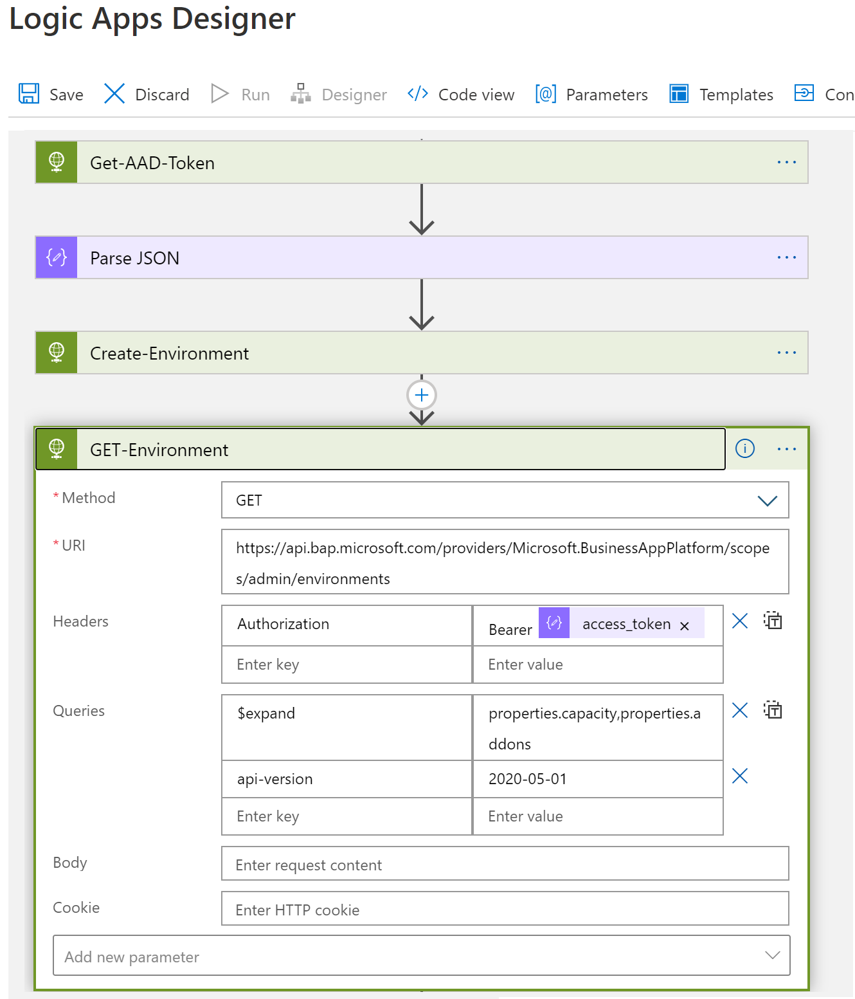
Full API Support for Environment Lifecycle Operations
CREATE
ADMIN MODE
BACKUP RESTORE
RESET
COPY

Slide 20
Power platform empowers IT admins with governance capabilities
Empowering admins with full visibility and the tools needed to balance business productivity with governance
Makes governance a mandate
Helps Develop & Implement a Strategy
Allows flexibility when needed
Notes:
Governance is a foundational part of the Power Platform because of its importance in the new world of end user developers. With the Power Platform, governance is a mandate and the Power Platform capabilities help promote the development and strategy of how an organization can manage an IT environment that includes citizen developers along with pro developers. The Power Platform also offers flexibility and customization on how an organization is governed.

Slide 21
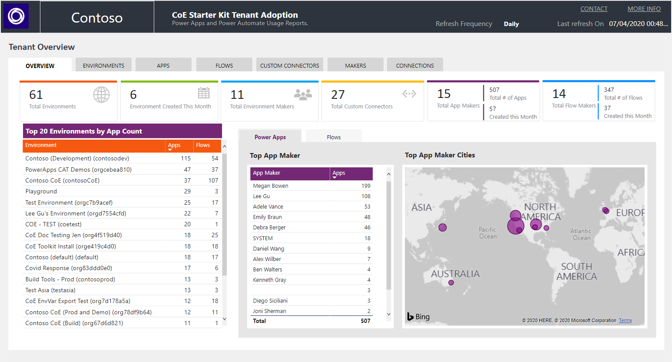
Enterprise Tooling - Center of Excellence Starter Kit
aka.ms/coestarterkit
Existing offering: Admin Center capabilities Extensibility via Connectors
Templates: A templatized implementation of best practices The CoE Starter Kit is a collection of components and tools designed to help you get started with developing a strategy for adopting and supporting the Power Platform.
Notes:
Beyond those tools is a Center of Excellence starter kit, maintained by the Power CAT team and represents what we’ve learned from some of the largest organizations implementing Power Platform. However, this is not a checkbox exercise. This tool, built in Power Platform, is intended to be just that: a starter kit for technology to enable your processes. It can help with the how, once you’ve established the what and why.
Some of the data and foundation you’ll likely need is in here, but your organization will undoubtedly want to tailor this for its own use. As you do, we would love to incorporate your innovations back into the tool. I’ll be showing the Center of Excellence start kit throughout the presentation today too.

Slide 22




Center of Excellence Starter Kit – Building Blocks
Admin
Gain Insights into your
Power Platform adoption
Governance
Establish Audit, Compliance and Archive processes
Nurture
Accelerate your adoption with a thriving community
Theming
Create, manage and share enterprise branded themes
Gain enterprise wide insights into your adoption
Drive your strategy with the value of analytics
Persona: Admin
Perform risk assessments, identify orphaned, complex and unused resources
Drive discipline through the right communication
Persona: Admin, Maker
Share best practices, onboard new makers, create excitement
Persona: Admin, Maker, End User
Provide makers with enterprise themes so they can focus on real business problems
Persona: Designer, Maker

Slide 23

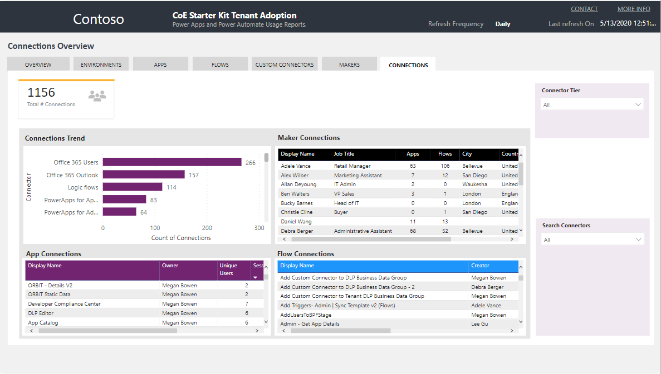


CoE Toolkit – Connector Usage
Identify the top connectors used
Find and add admins as owners for apps that leverage certain connectors (flow)
Find and disable flows that leverage certain connectors (flow)
Identify potential Data Loss Prevention policy updates or changes.
Notes:
Also monitor connector usage. See how data is being used and who is using it. Administrators can use this to affect DLP policy changes, or disable flows that are using connectors improperly. This action can be automated in the CoE toolkit too.

Slide 24

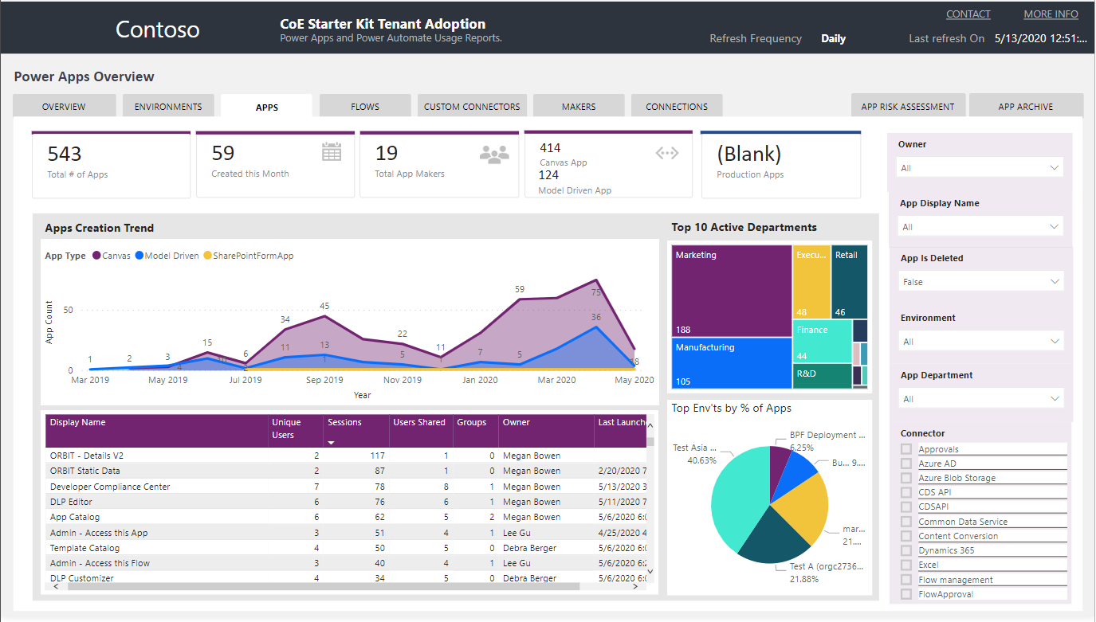



CoE Toolkit – Application Monitoring
See application creation trends
Understand sources of new apps
Identify apps that are broadly shared
See App usage through sharing, unique users and launch recency
Notes:
Moving on to applications. The CoE toolkit gives administrators a summary view of all of the applications. Identify the sources of new apps and find pockets of success. Find apps that are broadly shared and control them.

Slide 25

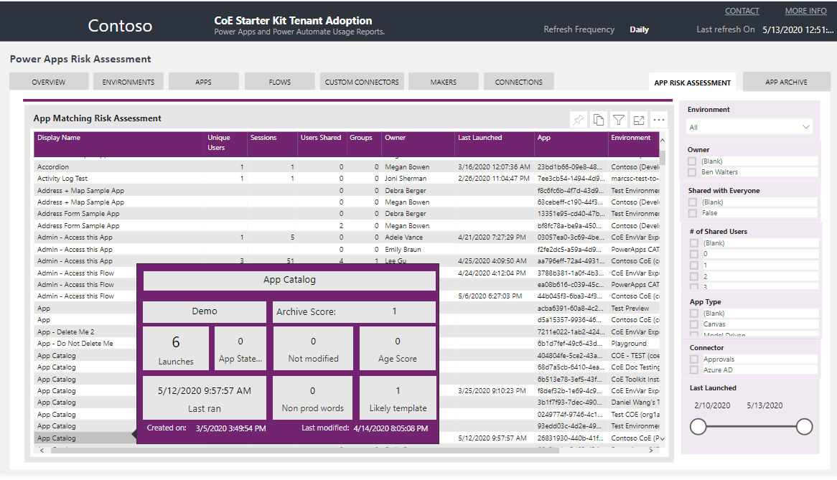



CoE Toolkit – Application Risk Assessment
Find overshared apps
Identify trials & template-based applications
Identify orphaned apps or flows
Find implicitly shared connectors
Notes:
The App Risk Assessment report aggregates data from across the platform to help you evaluate orphaned apps (those where the owner has left the organization), find those based on templates (training/evaluation exercises) and identify implicitly shared connectors to ensure they’re being used properly.

Slide 26

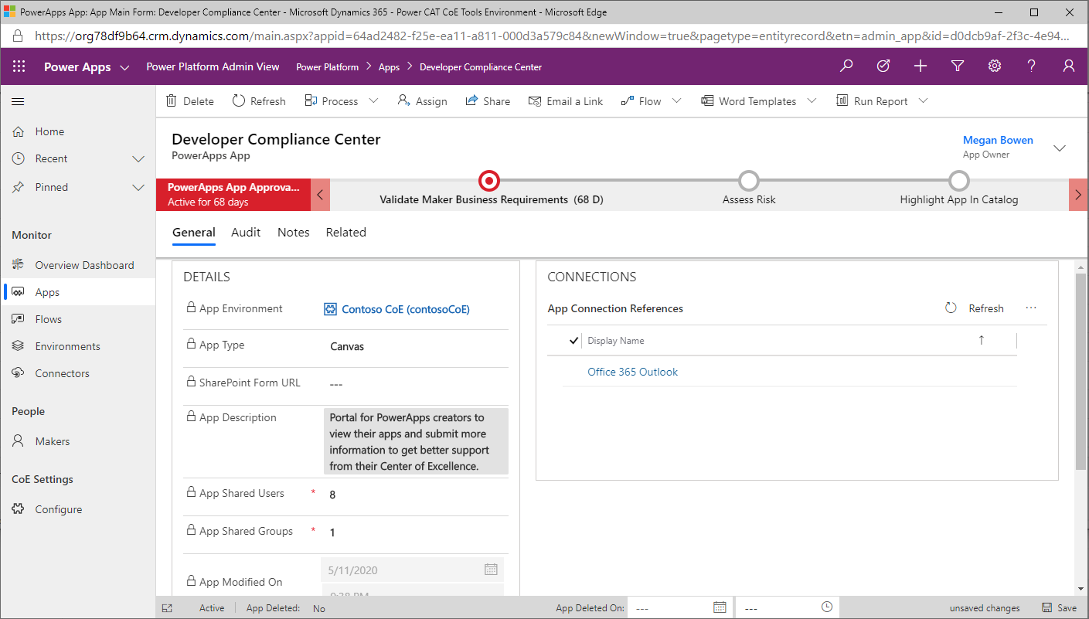


CoE Toolkit – Power Platform Admin View
Automate process for taking successful team-based application to enterprise use
Ensure highly used applications are reviewed
Define processes for risk level and metadata for publishing in app catalog
Notes:
The CoE toolkit will maintain a database of applications and provides a structure for an application review cycle. For example, use this capability to implement a review policy for applications that are shared with more than a certain number of users or teams—apps that are crossing the threshold from small team based applications to larger enterprise use.

Slide 27
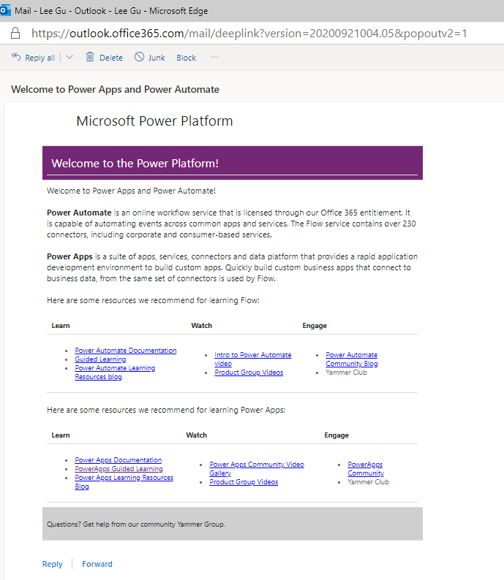
Welcome email
Sends an email to makers who create an app, flow or connector for the first time Adds new makers to an Office 365 Security Group

Slide 28
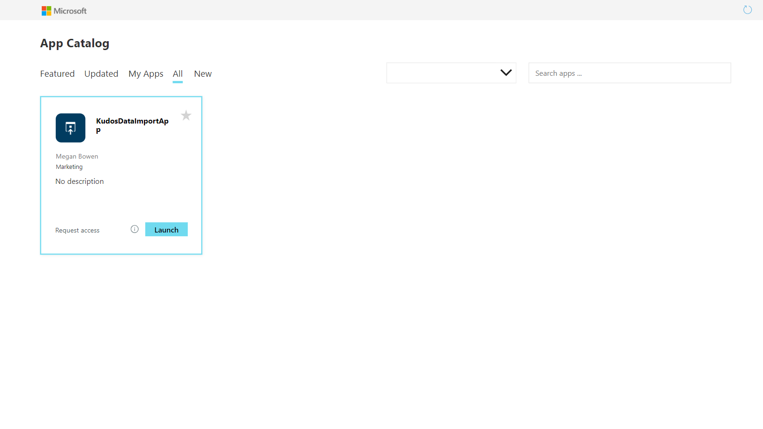
App Catalog
Make Apps more discoverable using the App Catalog Admins audit and validate apps which are then graduated to the App Catalog

Slide 29
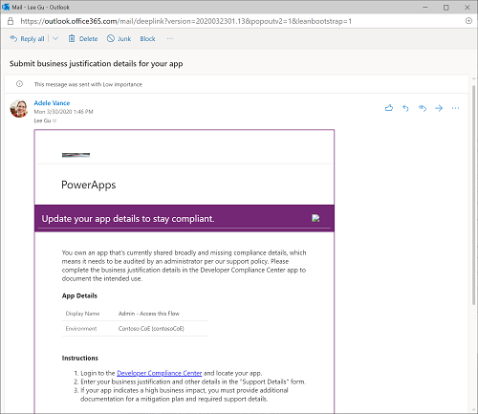
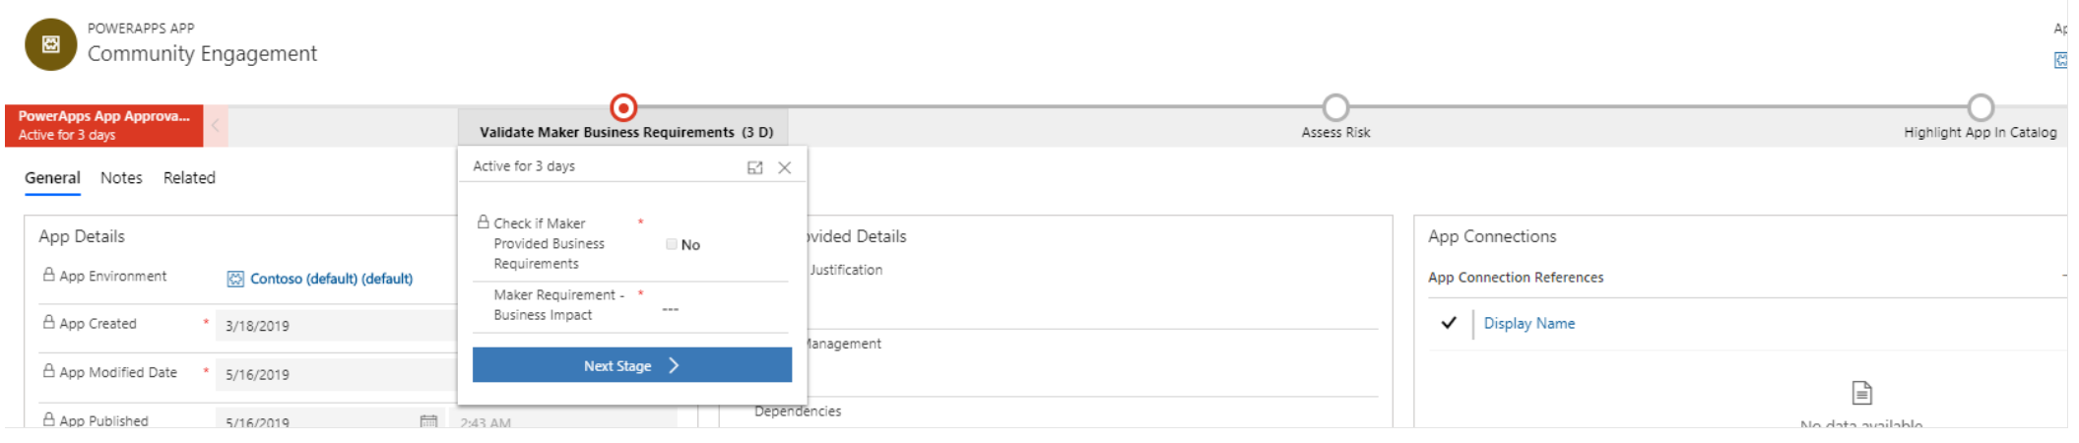
Establish and automate your audit process
Best
Practice
#4
Create your own workflows using the management connectors that permit or restrict behavior based on your organization’s policies (e.g. create an attestation process for assets in the default env)
CoE starter kit comes with its own audit workflow:
Apps are identified by a flow based on criteria such as the app is shared with > 20 Users or at least 1 group and the business justification details have not been provided.
Developer Compliance Center where the maker can provide a justification
Admin business process workflow for approval

Slide 30
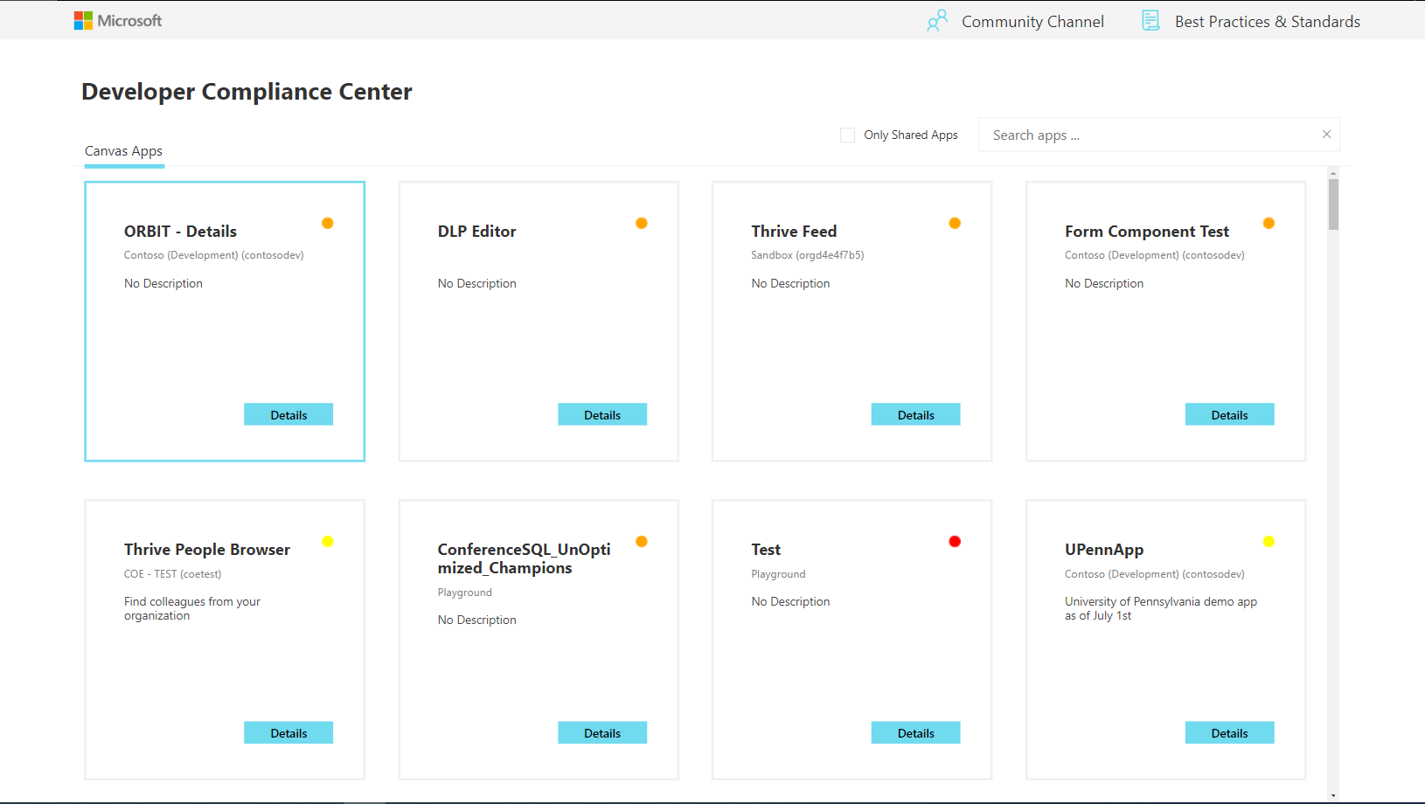
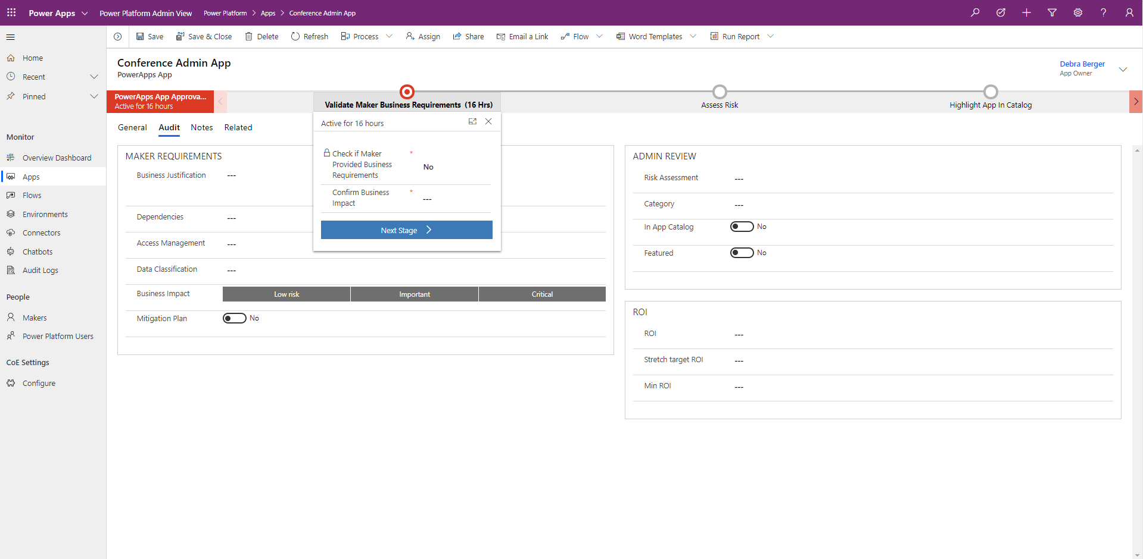
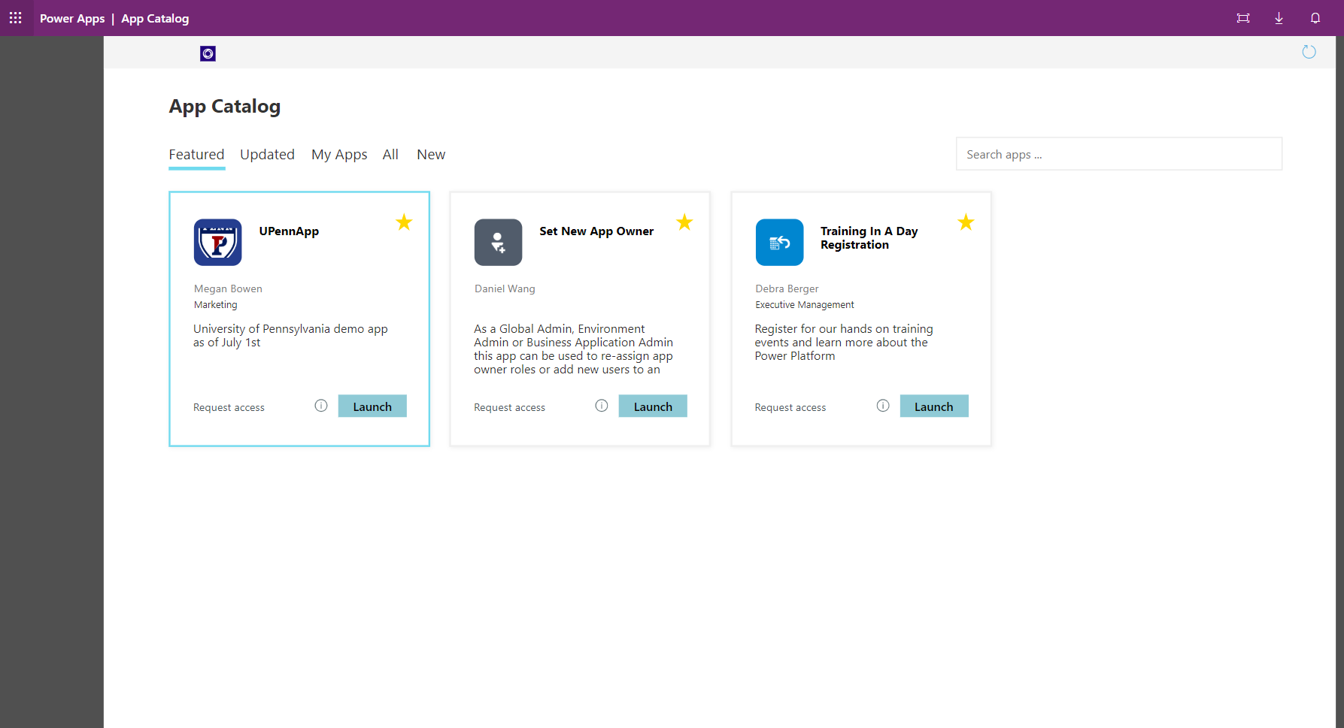

Center of Excellence – App Auditing Process
Admin | Compliance Detail Request
Flow iterates through resources and checks if they are compliant
Email to App Owner
App Owner is notified if their app is not compliant
Developer Compliance Center App
App Owner provides business justification and support details
Power Platform Admin View
Business Process Flow in the admin app facilitates auditing process
App Catalog
Admin can publish the app in the app catalog
System
System
App owner
CoE Admin
CoE Admin

Slide 31
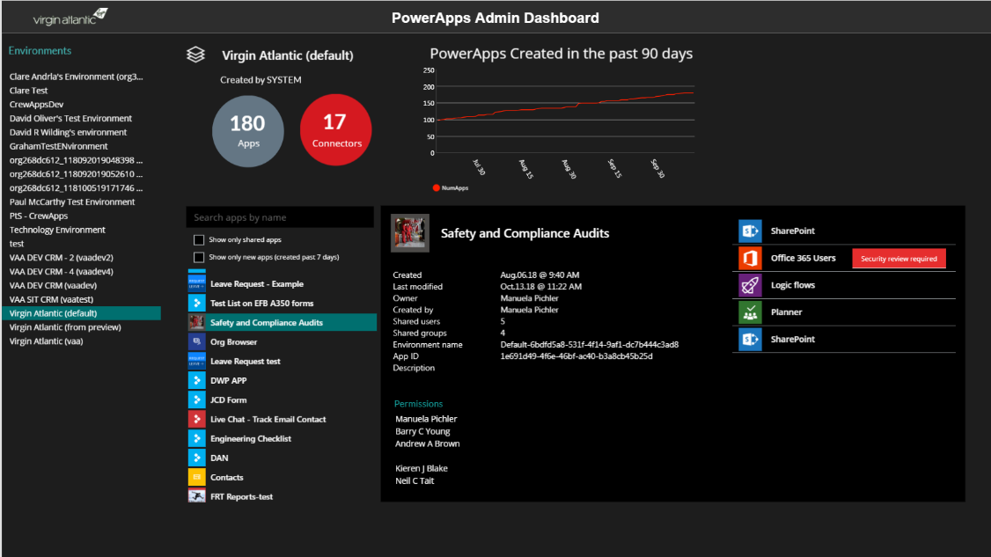
“An app to rule all Power Apps” (Virgin Atlantic)
Top level stats - # of apps, connectors, and app growth
List of environments
App details
Creator
Date created
Who is the app shared with
Description
…and more
Search and filter
show only shared apps
show new apps
List all connectors used by the app
List all apps in the environment
This is a Power Apps app that uses the Power Apps Admin connectors – http://aka.ms/adminconnectors

Slide 32






Center of Excellence Starter Kit – Get Started
Get familiar with the documentation at aka.ms/coestarterkit – check out the “What’s in the CoE Starter Kit” and “How to use the CoE Starter Kit” sections
Install the Admin (Core) Components solution and configure the Power BI Dashboard. If you already have adoption through organic growth, get familiar with your resources and makers in your environment.
Plan your data loss prevention (DLP) policy strategy and use the DLP Editor (canvas app) to mitigate the risk of negatively affecting apps when making changes to your policies.
Identify orphaned resources and assign them to new owners by using the embedded app in the Power BI dashboard. Identify unused resources and propose for them to be archived. Identify highly used and critical resources and work on a support plan for those.
Start planning your governance strategy by identifying your requirements for what makes a compliant app or maker, what information you'll need per app or per maker, what happens to noncompliant apps and makers, how you'll support your maker community in building compliant apps that follow best practices, what audits you want to run, and what actions you'll drive based on those audits.
Embrace your maker community and develop a nurture and adoption strategy. Think about how to onboard new makers; organize internal events such as show-and-tell sessions, training workshops, and hackathons; and put together templates and best practices for your makers to use.

